Slide 1

Bank Attrition Analysis
Sara Nedessa
ISM 6353
Notes:
Image: https://jencw.nl/business-intelligence/

Slide 2
Business Problem
Predict which customers are likely to churn
Motivation
New customers are expensive
Long-term customers generate increased profits and referrals
Stakeholders
The bank
Customers
5x
More expensive to gain new customers compared to retaining current customers
Data Description & EDA
Business Understanding
Data Description & EDA
Predictive Models
Results & Evaluation
Recommendations
Predictive Models

Slide 3
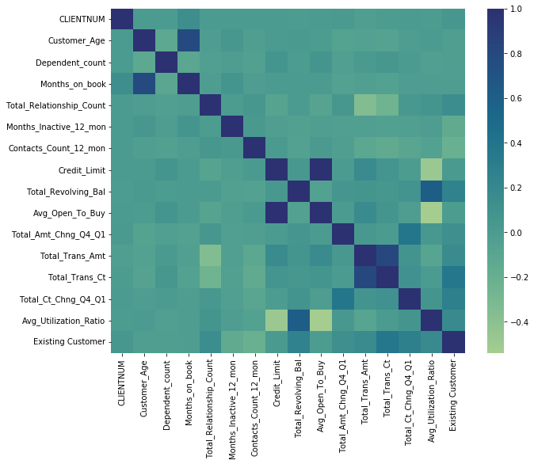
Dataset
10,000+ datapoint with 21 columns
Target Variable
Customer attrition
16% churn rate
Independent Variables
Customer demographic
Relationship with Bank
Data Description & EDA
Business Understanding
Data Description & EDA
Predictive Models
Results & Evaluation
Recommendations
Predictive Models

Slide 4
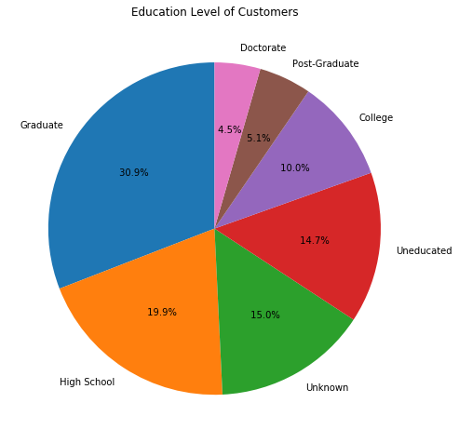
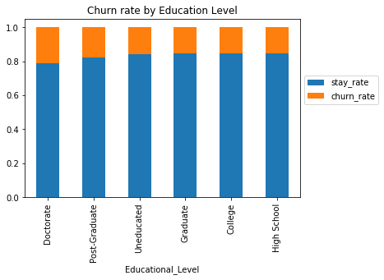
EDAs on Demographics
16%
Customers churned
Data Description & EDA
Business Understanding
Data Description & EDA
Predictive Models
Results & Evaluation
Recommendations
Predictive Models

Slide 5
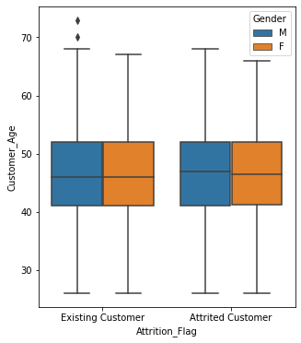
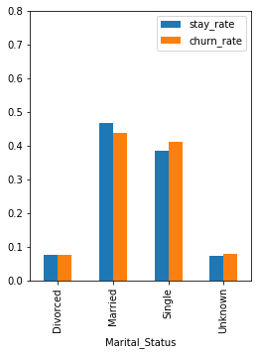
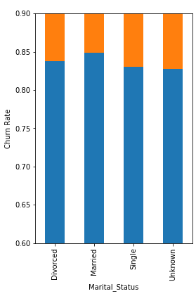
EDAs on Demographics
Data Description & EDA
Business Understanding
Data Description & EDA
Predictive Models
Results & Evaluation
Recommendations
Predictive Models

Slide 6
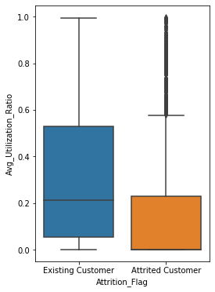
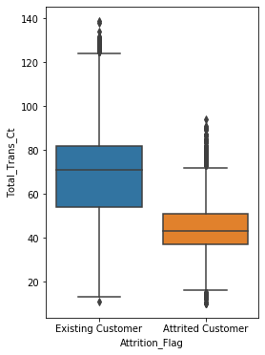
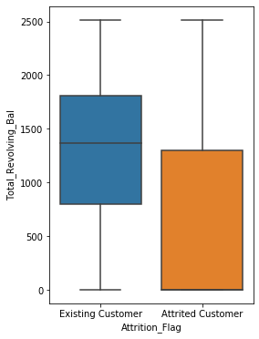
EDAs on Customer-Bank Relations
Data Description & EDA
Business Understanding
Data Description & EDA
Predictive Models
Results & Evaluation
Recommendations
Predictive Models

Slide 7
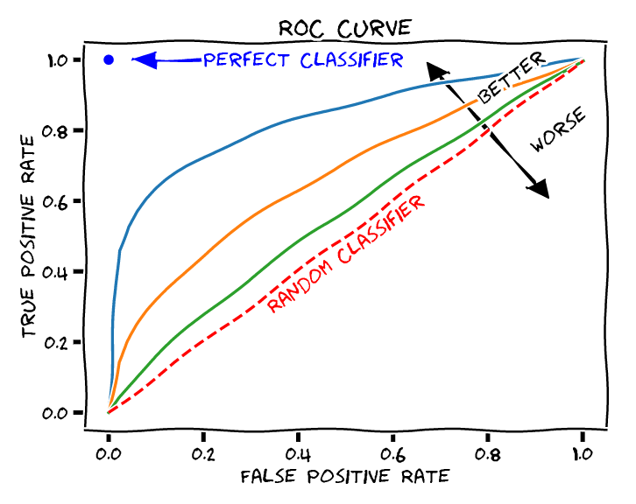
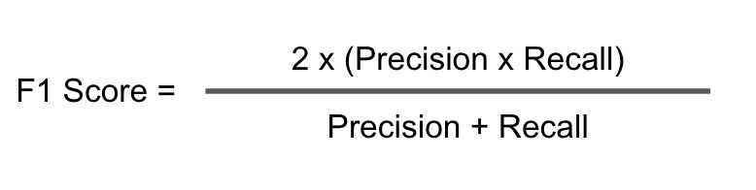
Predictive Models
Logistic Regression
Evaluation Metrics
Random Forest
AdaBoost
Sklearn
F-1 Score
X_train, X_test, y_train, y_test = train_test_split(X, y, test_size=0.3, random_state=101)
AUC
Accuracy
Data Description & EDA
Business Understanding
Data Description & EDA
Predictive Models
Results & Evaluation
Recommendations
Predictive Models

Slide 8
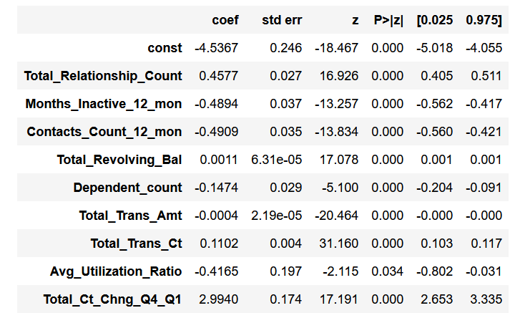
Logistic Regression
Used statsmodel to doublecheck chosen features have p-value <0.05
Model
model_lg = LogisticRegression().fit(X_train, y_train)
Model: Logistic Regression
F1-score: 0.93
AUC: 0.71
Accuracy: 0.88
Data Description & EDA
Business Understanding
Data Description & EDA
Predictive Models
Results & Evaluation
Recommendations
Predictive Models

Slide 9
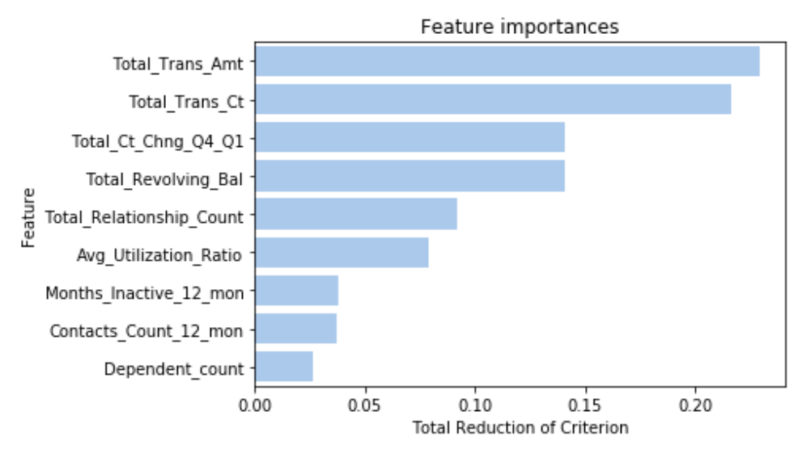
Random Forest
Doublecheck importance of chosen features
Model
model_rf =
RandomForestClassifier
random_state=101).
(n_estimators=100,
fit(X_train, y_train)
Model: Random Forest
F1-score: 0.98
AUC: 0.92
Accuracy: 0.96
Data Description & EDA
Business Understanding
Data Description & EDA
Predictive Models
Results & Evaluation
Recommendations
Predictive Models

Slide 10
AdaBoost
Boosting Ensemble model
Model
model_ada = AdaBoostClassifier
(n_estimators=100,
Random_state=101).fit(X_train, y_train)
Model: AdaBoost
F1-score: 0.97
AUC: 0.92
Accuracy: 0.96
Data Description & EDA
Business Understanding
Data Description & EDA
Predictive Models
Results & Evaluation
Recommendations
Predictive Models

Slide 11
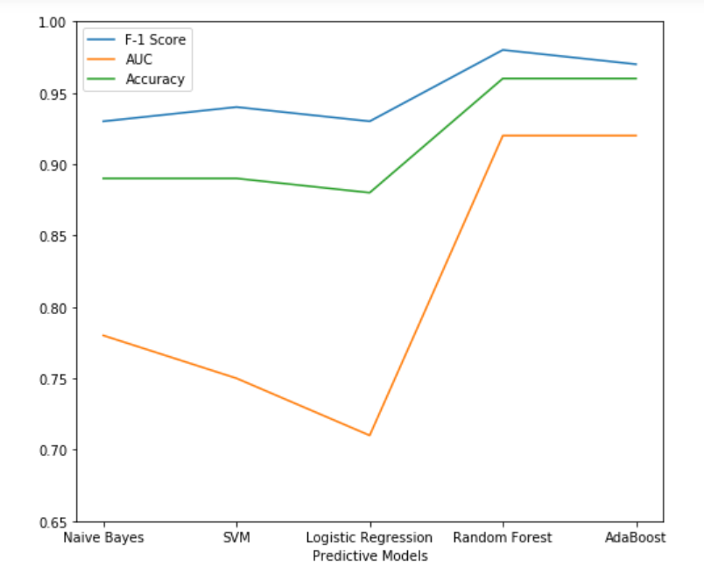
Model Comparisons
Model: Logistic Regression
F1-score: 0.93
AUC: 0.71
Accuracy: 0.88
Model: Random Forest
F1-score: 0.98
AUC: 0.92
Accuracy: 0.96
Model: AdaBoost
F1-score: 0.97
AUC: 0.92
Accuracy: 0.96
Data Description & EDA
Business Understanding
Data Description & EDA
Predictive Models
Results & Evaluation
Recommendations
Predictive Models

Slide 12
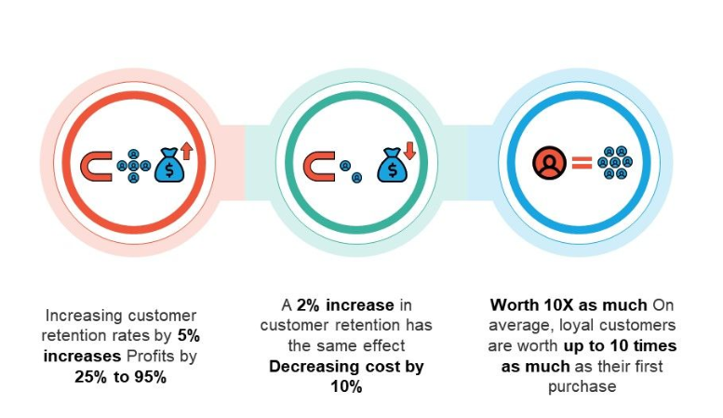
Conclusion
Banks can use predictive models to predict customers that will churn
Recommendations
Quarterly predictive models
Ensemble models are particularly effective
Improve these models as more customers join the bank (check for overfitting)
Banks should create incentive programs targeted towards these people to increase customer retention
Data Description & EDA
Business Understanding
Data Description & EDA
Predictive Models
Results & Evaluation
Recommendations
Predictive Models
Notes:
Image: https://www.revechat.com/blog/customer-retention-strategies/

Slide 13
Thank you!

Slide 14
References:
Chitra, K., & Subashini, B. (2011). Customer retention in banking sector using predictive data mining technique. In ICIT 2011 The 5th International Conference on Information Technology.
Verbeke, W., Dejaeger, K., Martens, D., Hur, J., & Baesens, B. (2012). New insights into churn prediction in the telecommunication sector: A profit driven data mining approach. European journal of operational research, 218(1), 211-229.
Van den Poel, D., & Lariviere, B. (2004). Customer attrition analysis for financial services using proportional hazard models. European journal of operational research, 157(1), 196-217.

